Slide 1
README
BURN AFTER READING
about_SlideDeck
The actual presentation starts with slide 6 ("Session title"). The first five slides have a purely organisational purpose. During the break before your session, you should start the presentation with slide 2 ("Next up"), so that the audience knows that they are in the right room. It's fine if you start chatting with the audience during this break, but we need a precise starting point for your presentation in terms of editing your video. That means:
The recording of your presentation will start after the countdown. Please (RE)START talking after the countdown, not during it! Otherwise your recording will start with a half sentence.
It is not necessary to explicitly signal to the PA operator, this is your signal!
Finally, do you have to use this slide deck? No, you are free to present the way you like it. But you are asked to use the intro slides: countdown, session title, sponsor slide. Beyond that, use what is good for the cause – from no slides to sketches from your children, from Jupyter to $youNameIt.
You will find additional information in the notes below.
Sincerely, your hosts!
Dear Speaker, we are thrilled and honored to have you with us in Antwerp in 2024. Take your time and read this before you prepare your session.
Since most of you have been with us before, you will already know a lot about PSConfEU. You know that we try to capture all sessions carefully and publish your work on YouTube. There are a few easily avoidable stumbling blocks that we would like to draw your attention to:
Your screen resolution should be 1920x1080 px (FullHD)
You should provide a full size HDMI socket
Mirror your screen
Disable "Presenter View" in PowerPoint
Using MAC or Surface book? Be aware of HDCP!
Notes:
The fine print (additional information)
Why should you care about HDCP?
"High-bandwidth Digital Content Protection (HDCP) is a form of digital copy protection developed by Intel Corporation to prevent copying of digital audio and video content as it travels across connections. Types of connections include DisplayPort (DP), Digital Visual Interface (DVI), and High-Definition Multimedia Interface (HDMI), as well as less popular or now deprecated protocols like Gigabit Video Interface (GVIF) and Unified Display Interface (UDI)."
https://en.wikipedia.org/wiki/High-bandwidth_Digital_Content_Protection
Some notebooks ignore the HDCP standard, some vendors comply with the standard. Apple and Microsoft are somehow famous for strictly following the HDCP guidelines. Sadly, we will not be able to guarantee, that your session can be recorded in the latter case.
But you can do simple things, to overcome these problems. It is also very likely that you presented with your notebook before. So you will know, if this worked fine.If you are in doubt and if the agenda allows, try a dry-run a day before and connect everything.
In general you can easily bypass HDCP restrictions with a cheap splitter (the cheaper the better), just like the one you see below. This is an example device that we bought for 16 euros (in Germany).
Ask us, we will lend you such a device.
Thorsten also gave a whole presentation about "Broadcasting yourself" - easy steps to record yourself and create a (backup) session recording on your own. If you want to invest your time and dive deeper, take a look at his recordings and notes:
https://vimeo.com/thorstenbutz/byourself
This is of course completely voluntary, but perhaps you will find it helpful.

Slide 2
Next Up: Execute Notebooks everywhere
David Sass

Slide 3
3
3

Slide 4
2

Slide 5
1

Slide 6
Execute Notebooks everywhere
David Sass
Notes:
Notebook demo
Notebook on Linux demo

Slide 7

Many thanks to our sponsors:

Slide 8
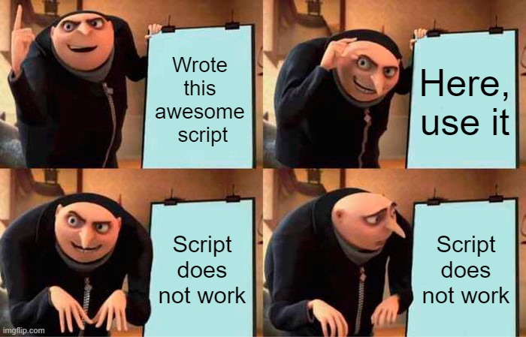
Before Notebooks

Slide 9

David Sass
Security Engineer at Switch
Former SRE
Recovering SharePoint Architect
Still dreams about Kerberos
Screams at the cloud
Relationship with Git is complicated
Will tell you Notebooks are awesome
dah-vEEd Schass
He/him/his/Skills

Slide 10
Who had this situation?

Slide 11

Works on my machine
Personal profile settings can alter behavior
Required modules missing
Module versions are wrong
Etc.

Slide 12
Proposal: Use PowerShell Notebooks
PS: Might not solve all your problems

Slide 13
PowerShell Notebook What?!
<<TODO insert boring stuff from Wikipedia>>
.NET Interactive Notebooks is now Polyglot Notebooks! - .NET Blog (microsoft.com)
Researchers use these – so must be good ☺
Doug Finke made an awesome module for Notebooks

Slide 14
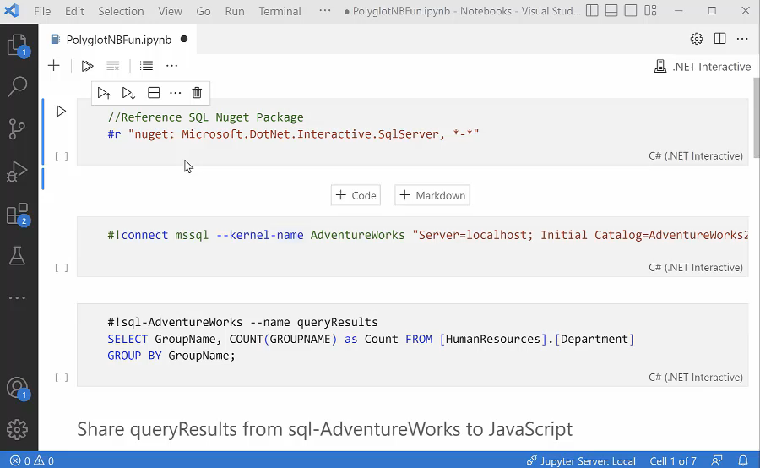

Slide 15
Why Notebooks ?
A Notebook is a self-contained solutions
Notebooks better than Containers
Can run virtually everywhere
Good for storing your memory digitally
Documentation built-in
Jupyter the VSCode extension is the 3rd most downloaded
Sharing is Caring

Slide 16
Demo #1
Notebooks basics

Slide 17
PowerShell Notebooks prerequisites
For editing
VSCode
PowerShell 7+
Jupyter extension pack from Microsoft
Polyglote Notebooks extension
Alternatively use dev containers
For execution
Install-Module ‘PowerShellNotebook’
Invoke-PowerShellNotebook

Slide 18
Demo #2
GitHub Actions

Slide 19
References
https://www.powershellgallery.com/packages/PowerShellNotebook
https://github.com/marketplace/actions/powershell-notebook-action
https://github.com/sassdawe/pwsh-notebook-tester
Ben Reader: Tuesday 14:00
No Passwords, No Problem: Secure Azure Authentication with MSAL & PowerShell
Emanuel Palm: Wednesday 10:00
From Cloudy to Clear: Demystifying Azure Authentication
Justin Grote: Wednesday 10:00
Building Custom GitHub Actions with PowerShell

Slide 20
Q&A
15 minutes

